Slide 1

Business Intelligence Mini Project
ITL602 BI LAB Semester VI
AY : 2023-2024
Votes Database
Submitted By
Akshata Nalavade 21104003
Manjiri Gole 21104006
Shweta Bhutada 21104007
Vedanti Nandvikar 21104024

Slide 2
1.Problem Definition
The problem addressed by this dataset is the classification of congressmen into two categories based on their voting records: democrat or republican. This classification task aims to predict the party affiliation of a congressman given their votes on various legislative issues

Slide 3
2. Dataset identified
Name of dataset: Votes Database
Dataset source: WEKA
Brief description of data:
A. Source Information: The data was sourced from the Congressional Quarterly Almanac for the specified session and congress. The donor of the dataset is Jeff Schlimmer, and the dataset was provided on April 27, 1987.
B. Relevant Information: The dataset includes votes on 16 issues, with each issue being represented as a binary attribute (voted for or against). Additionally, there's an attribute indicating party affiliation. The voting options are simplified to 'y' (voted for), 'n' (voted against), and '?' (unknown or abstained).

Slide 4
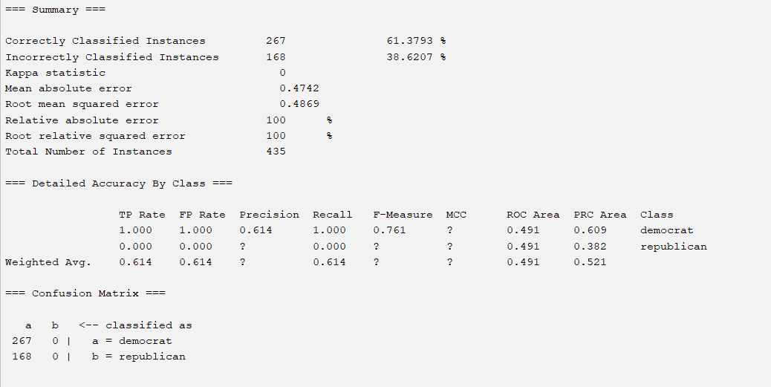
3. Data mining task performed
ZeroR Classification

Slide 5
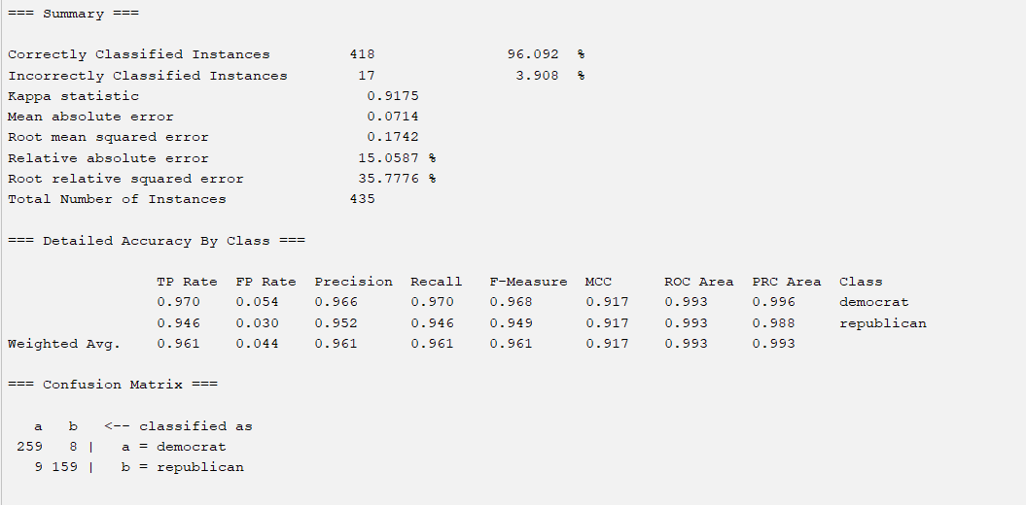
2. RandomForest Classifier:

Slide 6
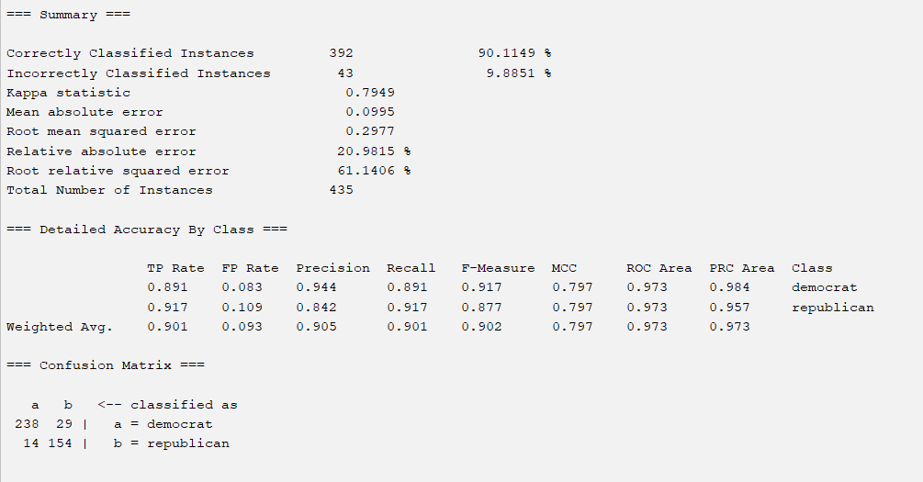
3. Naive Bayes Classifier:

Slide 7
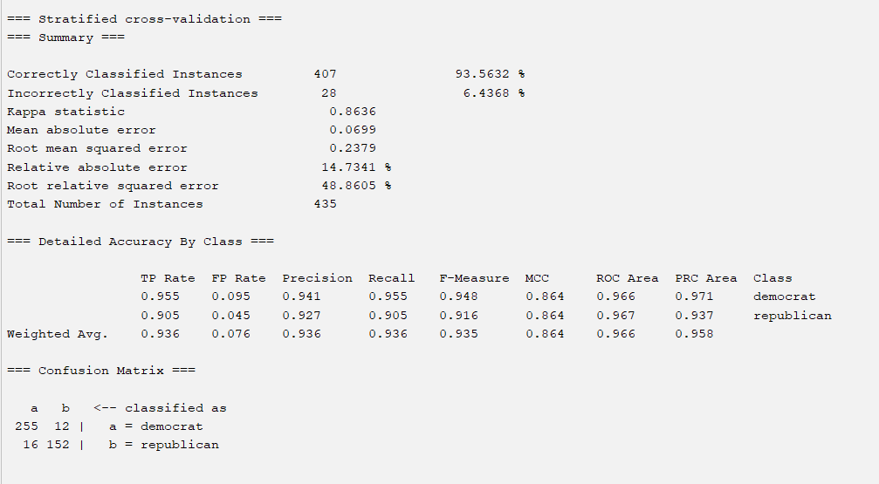
4. RandomTree Classifier:

Slide 8
4. Conclusion
In summary, RandomForest is the best classifier among the three for this dataset, considering its high accuracy as 96.092% and ability to capture complex patterns. Naive Bayes also performed well and is simpler and more interpretable, but RandomForest achieved better accuracy in this case. ZeroR, being a baseline classifier, provided the lowest accuracy and minimal insights into the dataset.

